Slide 1
WOWPE PAYMENT GATEWAY SOLUTIONS
Sunil R Sunkad
22nd Oct 2024

Slide 2
TECHNICAL PRODUCT MANAGER ASSIGNMENT
Business Requirement: Build a UPI Payment System towards a secure payment gateway
The goal is to show how you can manage product development by building features like secure UPI transactions, user registration, and transaction history.
Technical Requirement:
1. Backend (ASP.NET Core):
Endpoints:
POST /api/users/register: Register users.
POST /api/upi/pay: Process UPI payments.
GET /api/upi/transaction/{id}: Get transaction details.
GET /api/upi/transactions/{userId}: Get transaction history.
Database: Use MongoDB to store users and transactions.
Security: Implement JWT authentication and encryption for sensitive data.
Validations: Ensure valid UPI ID, sufficient balance, and input checks.
2. Frontend (Angular):
Dashboard: User registration, payment processing, and transaction history.
Use Angular Material for UI.
Http Client: Communicate with the backend API and handle JWT. 3.
3. Testing: Write unit tests for the backend (xUnit/NUnit) and frontend (Jasmine/Karma).

Slide 3
TECHNICAL PRODUCT MANAGER ASSIGNMENT
Deliverables:
GitHub Repository: Include complete code and a README with setup instructions.
API Documentation: Use Swagger or Postman for API docs

Slide 4
Solution Architecture
System Architecture Overview
Frontend: Angular for UI, using Angular Material for a clean dashboard.
Backend: ASP.NET Core to handle API requests and business logic.
Database: MongoDB to store user and transaction details.
Authentication: JWT-based authentication for secure communication.
Testing: Unit tests for backend using xUnit/NUnit and for frontend using Jasmine/Karma.
Security: Encryption for sensitive data, JWT-based authentication, and input validations.
Notes:
System Architecture Overview
Frontend: Angular for UI, using Angular Material for a clean dashboard.
Backend: ASP.NET Core to handle API requests and business logic.
Database: MongoDB to store user and transaction details.
Authentication: JWT-based authentication for secure communication.
Testing: Unit tests for backend using xUnit/NUnit and for frontend using Jasmine/Karma.
Security: Encryption for sensitive data, JWT-based authentication, and input validations.

Slide 5
FLOW ARCHITECTURE
Backend Structure
Controllers:
UsersController.cs: Handle user registration.
UPIController.cs: Manage UPI payments and transactions.
Models:
User: Represents a registered user.
Transaction: Stores transaction details.
Services:
UserService: Manages user data.
TransactionService: Handles payment and transaction logic.
JwtService: Handles token generation and validation.
Frontend Structure
Components:
RegisterComponent: Handles user registration.
DashboardComponent: Shows user dashboard with payments and transaction history.
PaymentComponent: Processes UPI payments.
Services:
AuthService: Manages JWT token.
PaymentService: Interacts with the backend for payments and transactions.

Slide 6
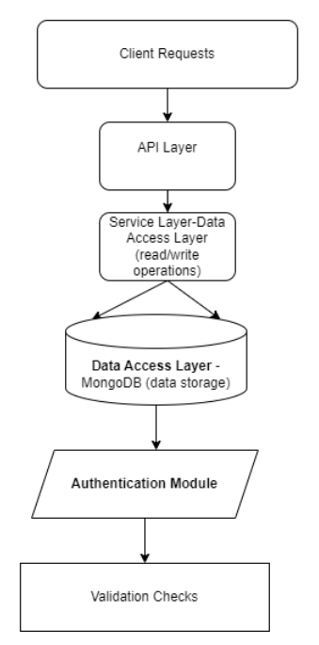
Architecture Diagram_ASP.NET Core API
Folder Structure :
Controllers
Models
Services (Business Logic)
Data (MongoDB Context)
Authentication (JWT Configuration)
Tests (xUnit/NUnit)
User Registration: POST /api/users/register
{
"name": "Sunil",
"email": "sunil92rs@gmail.com",
"password": "Sunil@123",
"upiId": "sunil@upi"
}
Validations: Ensuring valid email, non-empty password, and UPI ID format.
Bussiness Logic:
Encrypt password using BCrypt.
Store user data in MongoDB.
Generate JWT token on successful registration

Slide 7
Architecture Diagram_ASP.NET Core API
Process UPI Payment: POST /api/upi/pay
{
"senderId": “sunil@upi ",
"receiverUpiId": "ABC@upi",
"amount": 500
}
Business Logic
Check sender’s balance.
Verify UPI ID format.
Deduct amount from the sender and store the transaction in MongoDB.
Return success response with transaction ID.
Get Transaction Details: GET /api/upi/transaction/{12 digit number }
Retrieve the details of a specific transaction using the transaction ID.
Get User's Transaction History: GET /api/upi/transactions/{sunil@upi}
Retrieve all transactions for a specific user.

Slide 8
DESIGN AND DATA FLOW
Frontend (Angular)
User interacts with the web app (registers, logs in, initiates payments).
Angular sends API requests to the backend for authentication, payment initiation, and status checks.
Displays QR codes for UPI payments (for P2P or merchant payments).
Backend (ASP.NET Core)
Handles user authentication (using JWT).
Stores user profiles and UPI IDs in MongoDB.
Initiates payment via the UPI gateway API and handles responses (success, pending, or failed).
Schedules payment status checks using background services (e.g., .NET Hosted Services).
Database (MongoDB)
Stores user details, payment transactions, and linked bank account/UPI ID information.
Payment Gateway (UPI Integration)
Razorpay, Paytm, or NPCI UPI API used to initiate and verify payments.
QR Code generator for payment requests.
Payment callback API to receive asynchronous updates about transaction status.

Slide 9
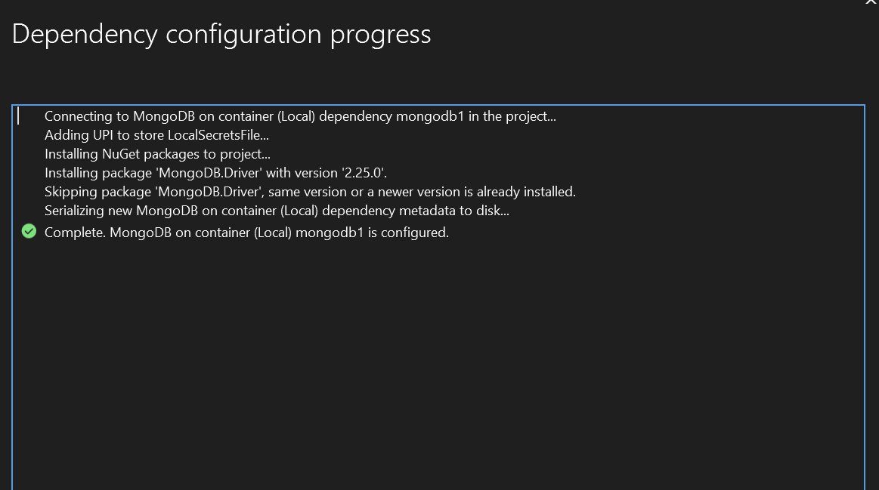
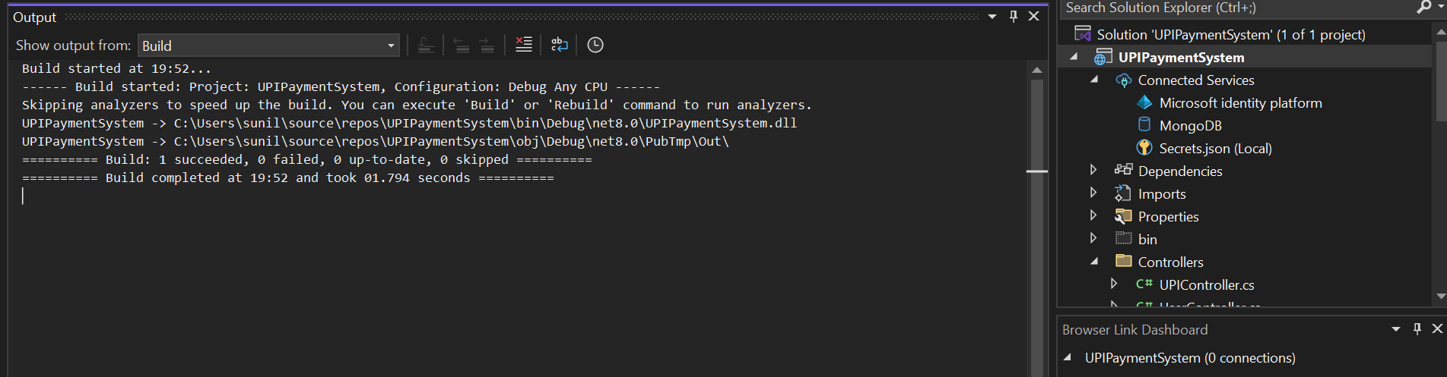
BACKEND ASP.NET.CORE API
Publish profile 'C:\Users\sunil\source\repos\UPIPaymentSystem\Properties\PublishProfiles\FolderProfile.pubxml' created.

Slide 10
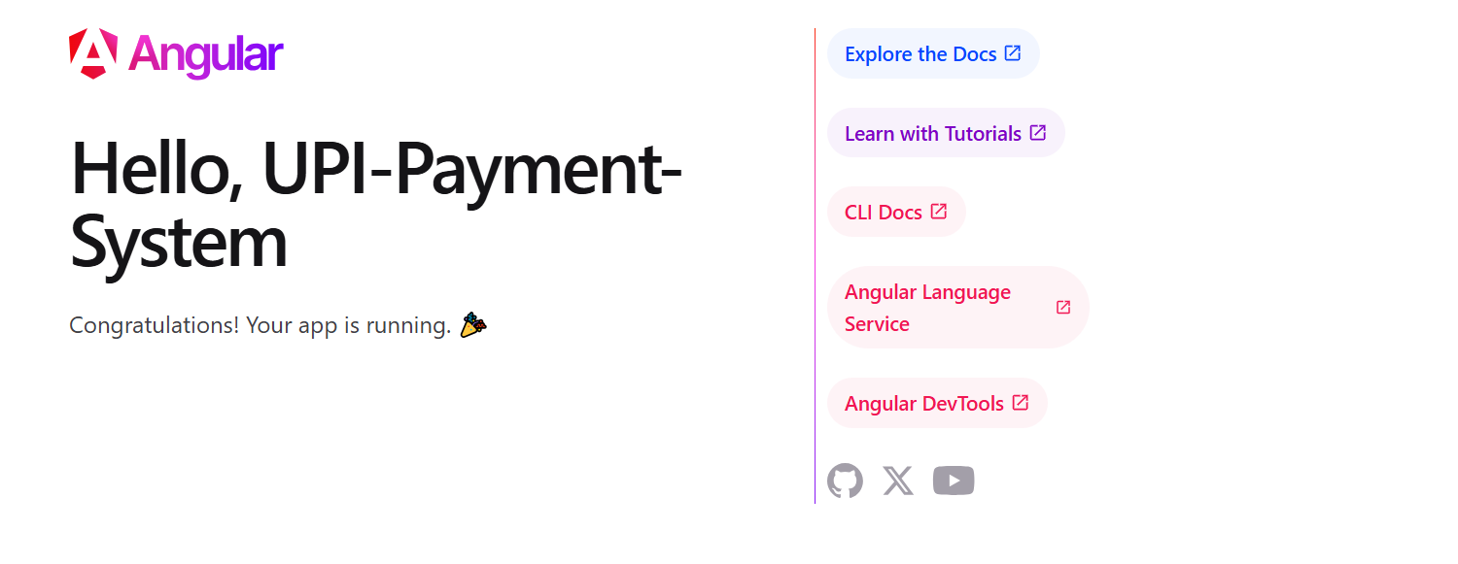
FRONTEND APP CREATED SUCCESSFULLY
ng serve

Slide 11
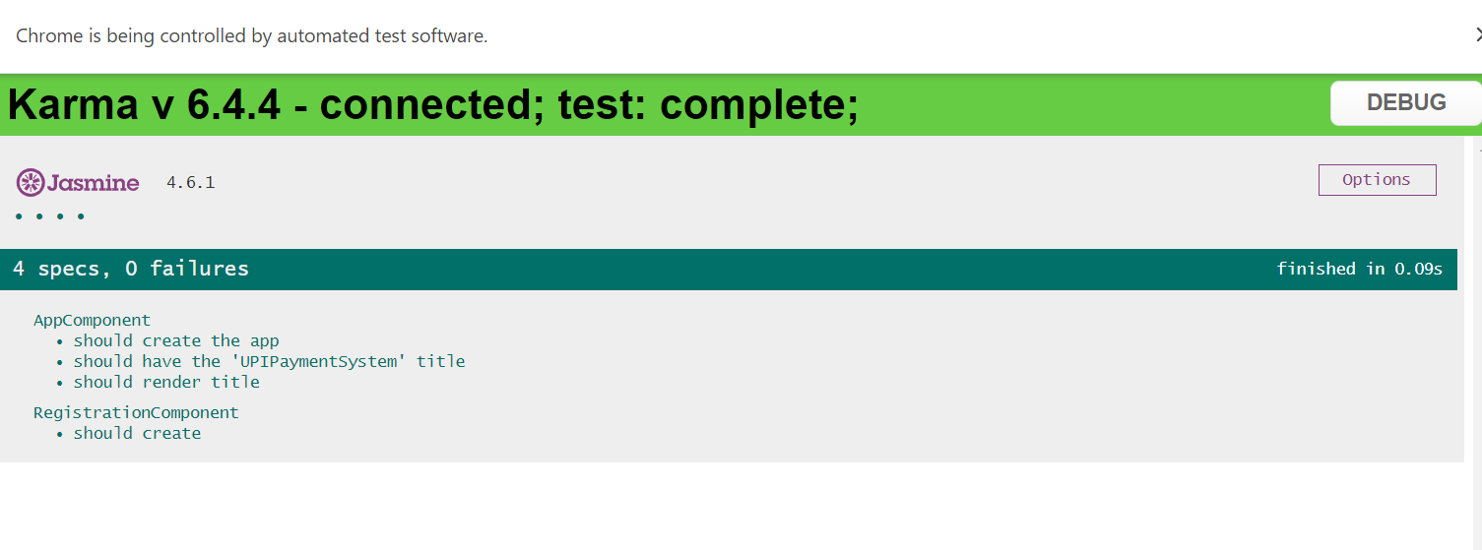
FRONTEND TEST SUCCESSFULL
5. Bonus: Real-Time Notifications (Optional)
Integrate SignalR for real-time payment notifications:Add SignalR to the backend and push real-time updates on transaction status.
Use Angular WebSocket in the frontend to display live notifications.

Slide 12

FINAL DELIVERABLES
Deliverables
GitHub Repository: Include full code with a clear README.
API Documentation: Use Swagger for API documentation --------dotnet add package Swashbuckle.AspNetCore

